Slide 1
Image Classification Wild Animal dataset
CSE428
Image Processing
Group 1
(20121050) Farhan Ahmad Nafis
(20101514) Ashraful Islam Nirob
20101609 ) Tahmidul Karim Takee
(21201837) Samanta Binte Taher
(20201033) Mashnoon Mayad

Slide 2
Contents
Dataset | The dataset and its properties
Dataset Distribution | Discuss the distribution of classes and if they’re balanced or not. Using plots
Unbalanced sets? | How do we deal with unbalanced sets should they arrive?
Logistic Regression | Classification attempt using Logistic Regression classifier
Neural Network | Classification attempt using Neural network classifier
Results and Comparison | Comparison and results between the two methods
For more info: SLIDESGO | BLOG | FAQs
You can visit our sister projects: FREEPIK | FLATICON | STORYSET | WEPIK | VIDEVO

Slide 3
Dataset
The given dataset represents a collection of wild animals

Slide 4
Dataset
The dataset is not too large, with 2400 images of wild animals between 5 classes of data.
The data is divided into two types: train and test. The training data is meant to train the model and testing data tests the results of training.
No validation sets were provided, so we used a 90:10 and 85:15 split for the logistic regression and neural net parts respectively.

Slide 5





The 5 possible classes are:
Boa constrictor
Bullfrog
Goldfish
Bear
Golden Retriever

Slide 6
02
Dataset Distribution

Slide 7
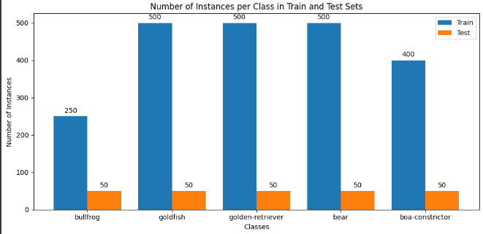
Dataset is broken down into two types: Train and test.
As stated before, there are 5 possible classes. There are many samples of images regarding of each class.
We represented this using a bar chart

Slide 8
The test data is however, balanced.
In terms of validation, we handled it by splitting the total images in train and test.
Due to there being relatively lower amount of samples for boa constrictor and bullfrog, the train data is unbalanced.

Slide 9
03
Unbalanced sets
.

Slide 10
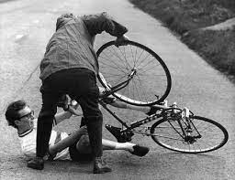
To deal with unbalanced data
We have used oversampling and undersampling to help us.
Oversampling copies the same data, or replacing new cases of it. It allows more data to be created without actually having to collect it.
Undersampling is when we do have more than enough of a certain class in the data.
We ignore certain instances to lower the number of data for that class.

Slide 11
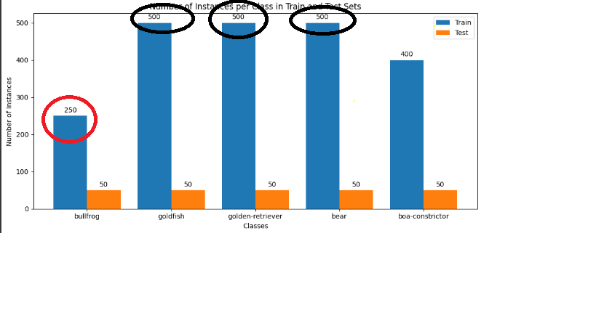
98,300,000
Big numbers catch your audience’s attention
The black ones need to be downsampled to meet with the the boa constrictor. In contrast, boa constrictor could also be upsampled.
The ‘bullfrog’ class will require upsampling it will be an unbalanced dataset even after downsampling if we do not upsample it to be equal to the others.,

Slide 12
04
Logistic Regression

Slide 13
We used the Logistic Regression model as our first classifier
After dividing the data into test and train, we run the model and find out the accuracy, sensitivity, specificity, positive predictive value (PPV), negative predictive value (NPV), the confusion matrix, and the F1 score

Slide 14
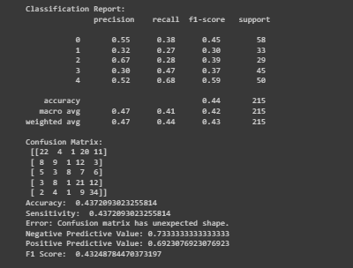
Train Data
The trained data model gives us an accuracy and sensitivity of approx. 43.7%
Our PPV value is 0.733
Our NPV is 0.692
We get an F1 score of 0.432
We do not get a Specificity value due to imbalanced dataset

Slide 15
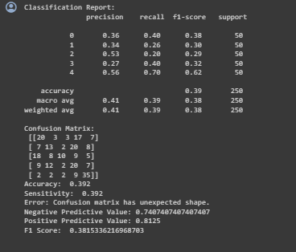
Test Data
The trained data model gives us an accuracy and sensitivity of approx. 39.2%
Our PPV value is 0.749
Our NPV is 0.812
We get an F1 score of 0.381
Again, we do not get a Specificity value due to imbalanced dataset

Slide 16
05
Neural Network

Slide 17
We used the Neural Network model as our second classifier
We use an input layer of (64,64,3)
We use 3 hidden layers with 64,128 and 256 neurons. The logistic activation function used was the sigmoid function.
After that, we have an output layer of 5 neurons. We also use softmax as our activation function
For our loss function, we use Categorical Cross Entropy with the ‘adam’ optimiser due to the multiclass nature of the data .
Finally, we run it through 25 epochs to complete our model. We then used the train data to check.
After dividing the data into test and train, we run the model and find out the accuracy, sensitivity, specificity, positive predictive value (PPV), negative predictive value (NPV), the confusion matrix, and the F1 score

Slide 18
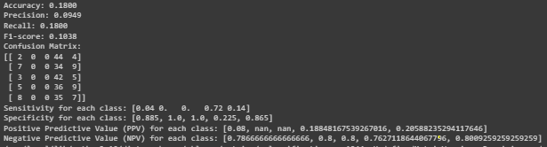
Test Data
The trained data model gives us an accuracy of approx. 18%
Precision is 9.59%
In this one, we measure sensitivity, specificity and NPV PPV by class.
Thus it measures classificational success in terms of the classes
Sensitivity for each class: [0.04,0,0,0.72,0.14]
Specificity for each class: [0.885, 1.0, 1.0, 0.225, 0.865]
Our avg PPV value is 0.095
Our avg NPV is 0.789

Slide 19
06
Result comparison

Slide 20
Result Comparison
Our metrics for success were as follows:
Specificity is when it can correctly identify negative values.
Sensitivity/recall measures how well the model can correctly identify instances of the positive class.
Positive Predictive Value (PPV) is the true positive cases from all the predicted positive cases
NPV denotes the true negative cases from all the negative cases the model predicted.
F1 is the harmonic mean of PPV and sensitivity. It is another way to predict accuracy.

Slide 21
Result Comparison
The PPV, NPV and accuracy were all higher, in favour of LR or similar.
Although the NN model showed impressive specificity and NPV, Logistic regression worked better.
An object of note is that the specificity of the logistic model was not being calculated due to the fact that the dataset used was unbalanced.
On a case by case basis, logistic regression seemed to clearly give us greater accuracy and precision.
Bearing in mind the limitations of using an ML approach for image based classification, Logistic regression seemed to work better for the job with a high accuracy and specificity.

Slide 22
Thanks!
Please keep this slide for attribution

